Slide 1
Programming with Objectives
CEIS150: Final Project
By: Kassandra Moreno

Slide 2
Introduction
In the following slides, you will find my academic journey of learning to program with objectives using Python. The application in use will be Spyder.

Slide 3
Agenda
Set-up
Text-Based User Interface Summary Report
Inheritance Summary Report
Creating a Chart in Spyder
Loading Data
GUI

Slide 4
Set-Up
Class Diagrams, Class Coding, Unit Testing

Slide 5
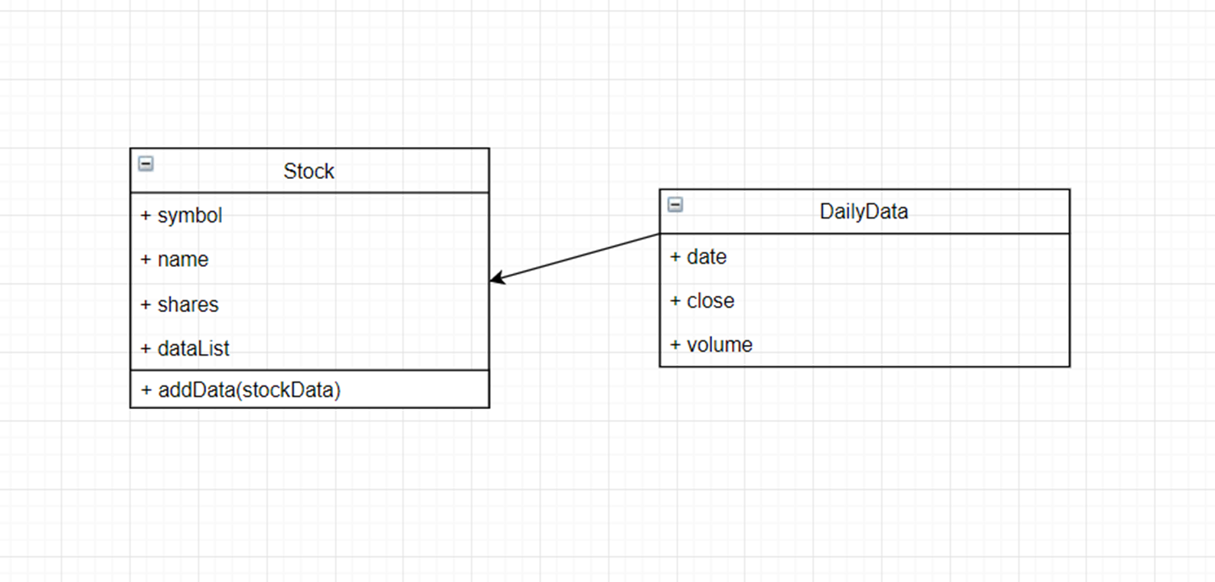
Class Diagram

Slide 6
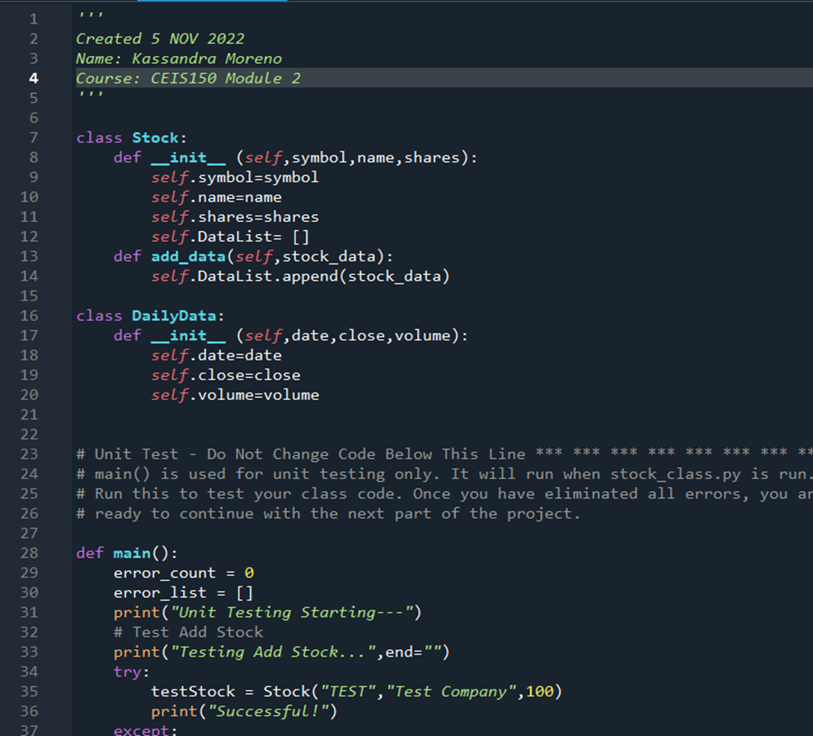
Class Code

Slide 7
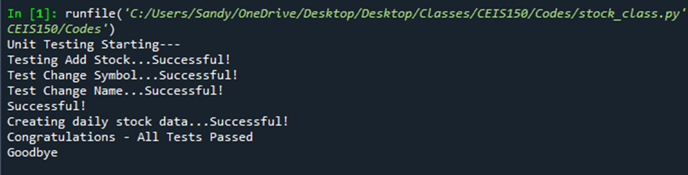
Unit Test

Slide 8
Summary Report
Text-Based User Interface

Slide 9
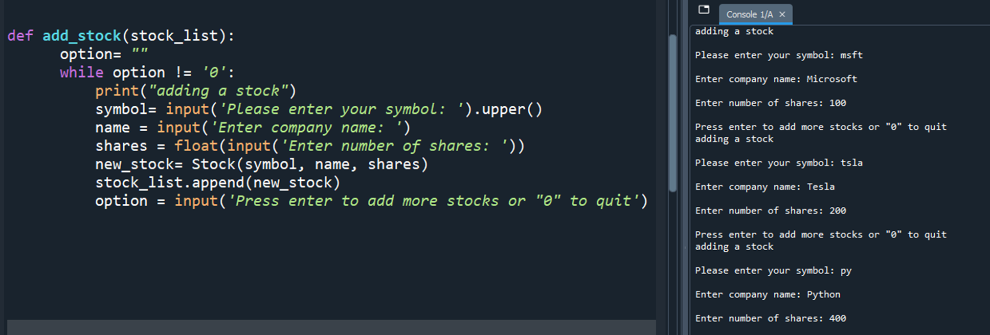
Adding Stock

Slide 10
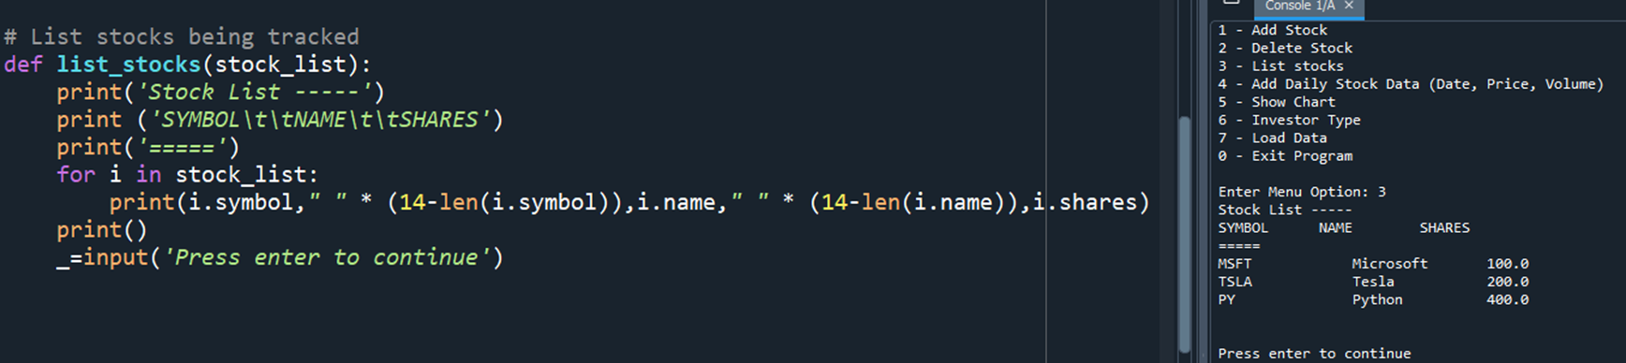
Listing Stocks

Slide 11
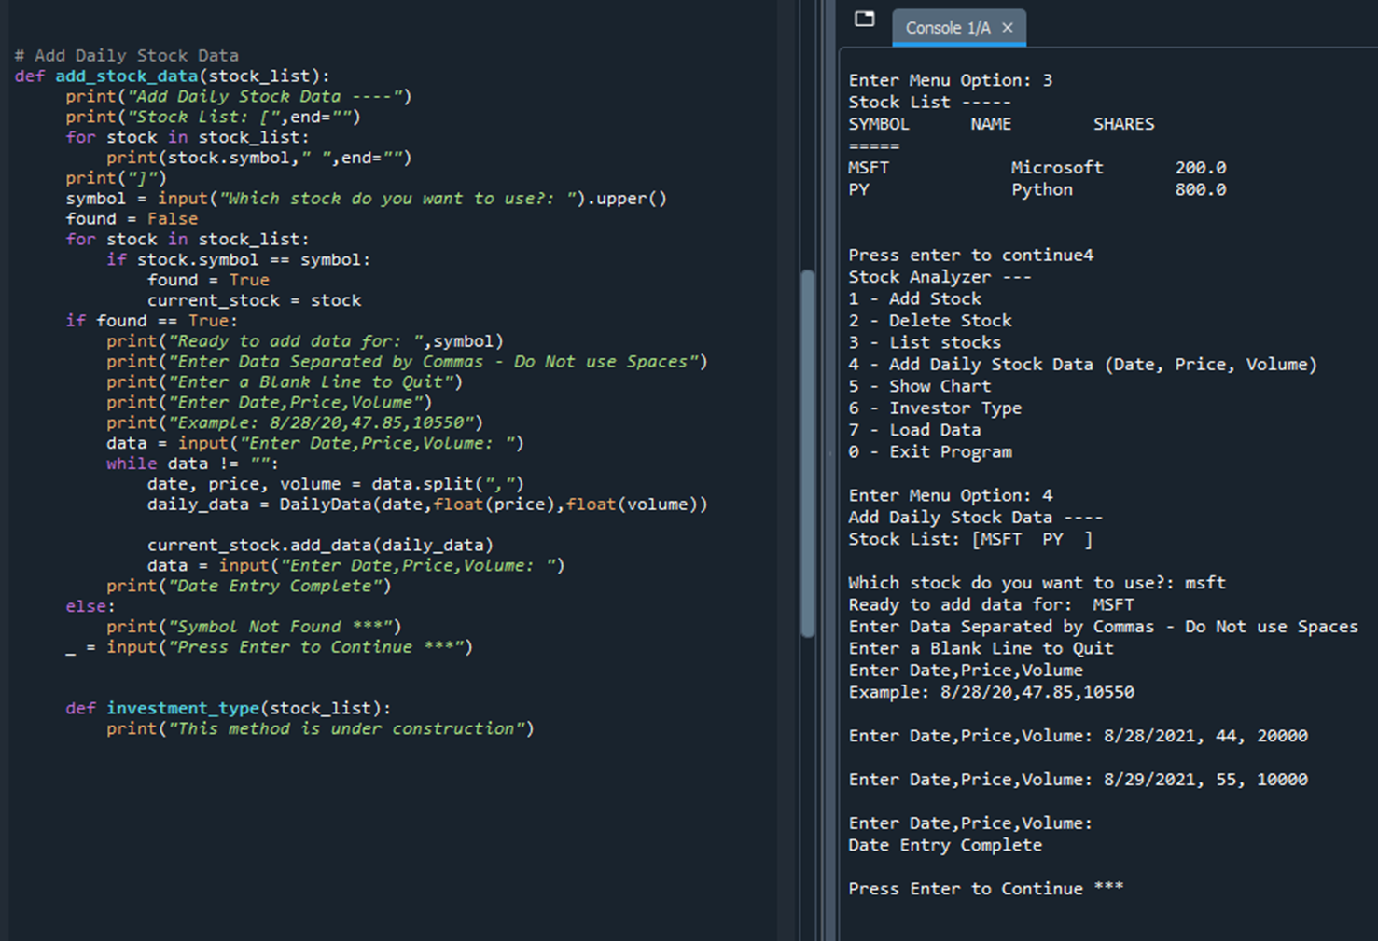
Daily Data

Slide 12
Summary Report
Inheritance

Slide 13
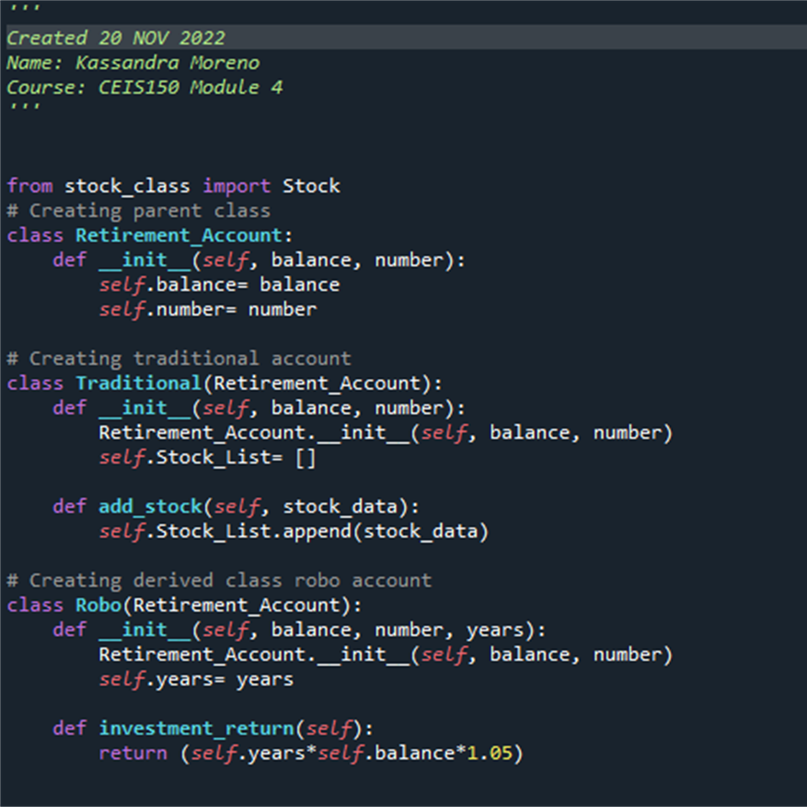
Inherited Classes

Slide 14
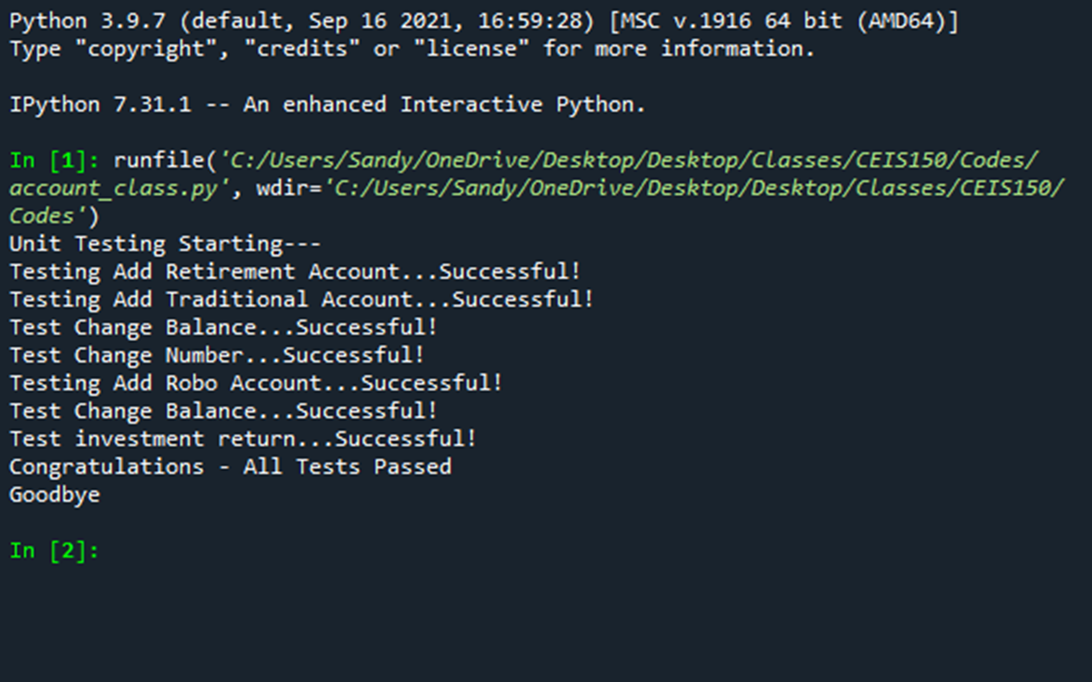
Unit Tests

Slide 15
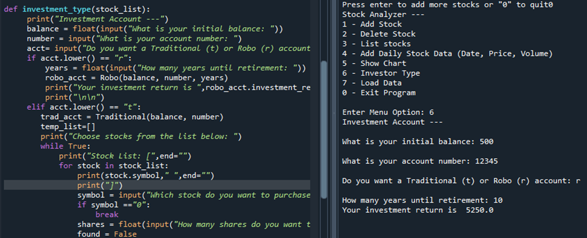
Stock Menu Program

Slide 16
Creating a Chart
In Spyder

Slide 17
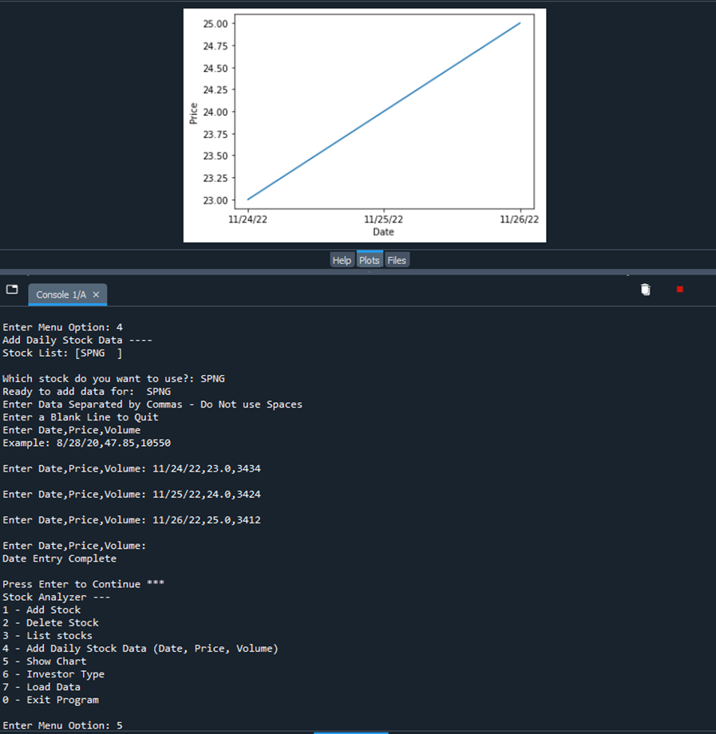
Chart

Slide 18
Loading Data

Slide 19
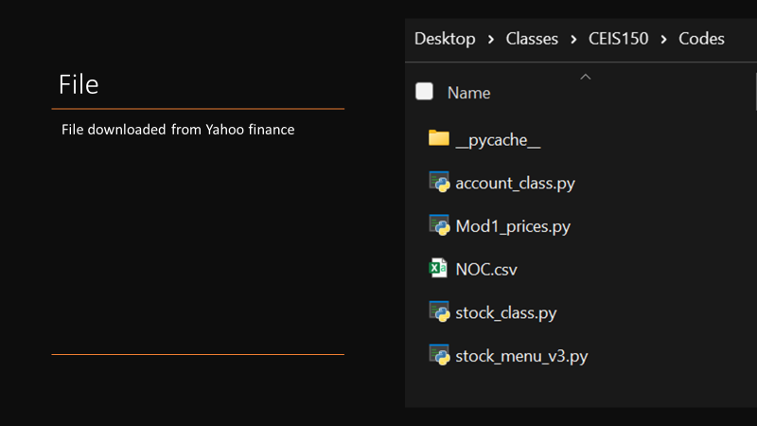
(NOC’s Data) File Location

Slide 20
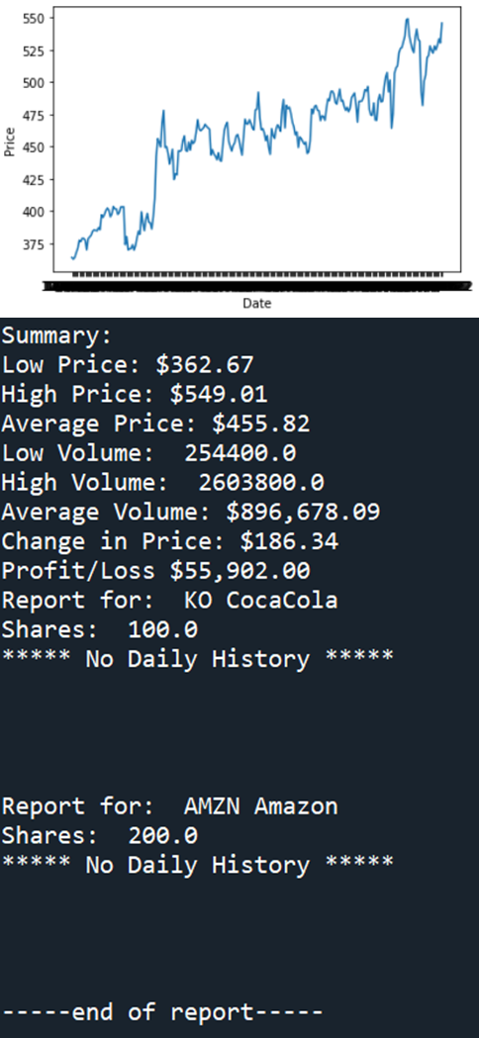
Importing Data

Slide 21
GUI
(Graphic User Interface)

Slide 22
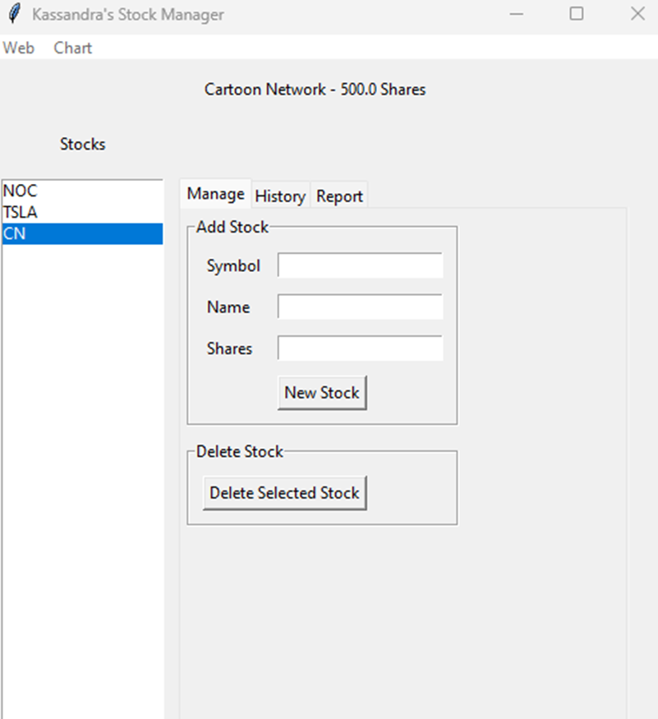
Stocks in GUI

Slide 23
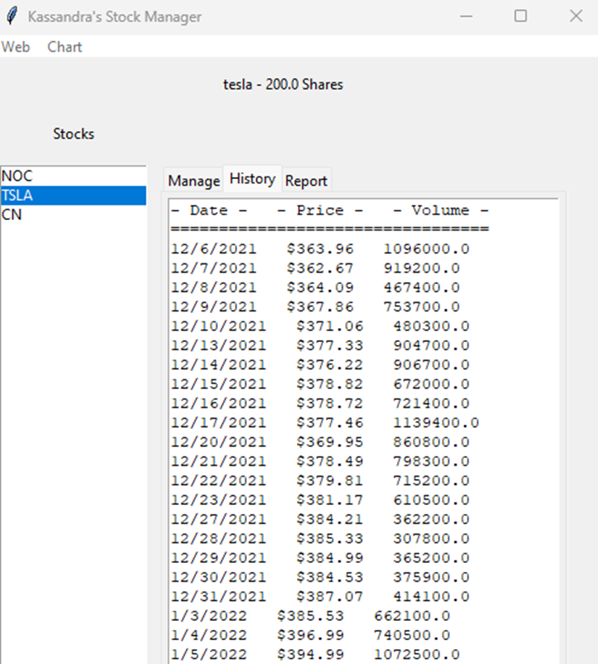
History Tab

Slide 24
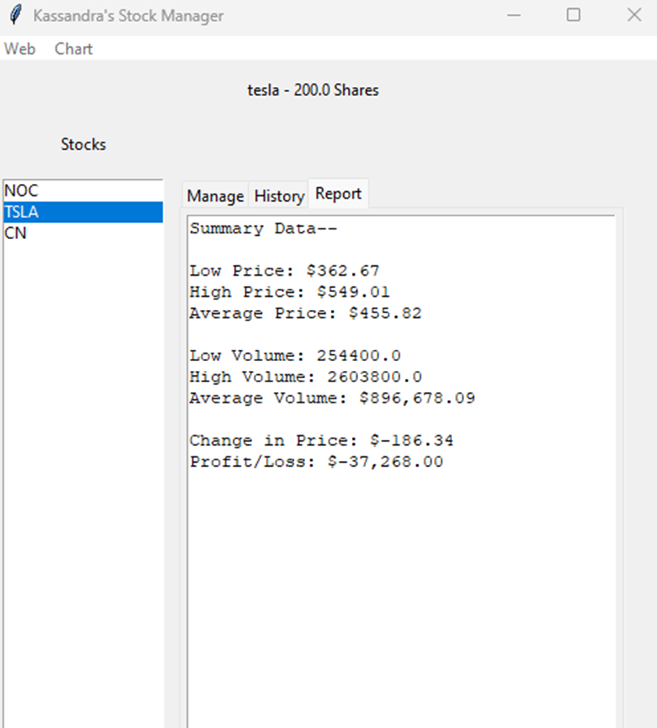
Report Complete

Slide 25
Challenges
One of the biggest challenges I faced throughout this project was remembering what the other coded files comprised and their exact spelling. I overcame this challenge by making a habit of opening every file involved in the project every time I code. This made quick referencing fast and effective and reduced my typos significantly.

Slide 26
Career Skills
Through this journey, I would have to say the biggest career skill taken from this experience was organization between multi-file codes.

Slide 27
Conclusion
The previous slides demonstrated my steps to create a program using objects to manage stock classes.

