Slide 1

Applied Physics
PHYS204: Final Project
By: Kassandra Moreno

Slide 2
Introduction
In this presentation, we will explore the laws of physics through labs I have conducted and documented. The topics to be discussed will be the following:
The Precision of an Ultrasonic Sensor
    Observing the laws of physics regarding ultrasonic waves with an ultrasonic sensor.
Gravitational Acceleration
  Calculating gravity’s effect on a falling object with an ultrasonic sensor and Excel.
Conservation of Energy
From Gravitational Acceleration data; observing changes in energy on a falling object.
Rotational Motion
Convert radial displacement to linear displacement using the rotary encoder.
Hall Effect
observe the Hall effect as a relationship between voltage and magnetic field

Slide 3
Materials Needed for Labs

Slide 4
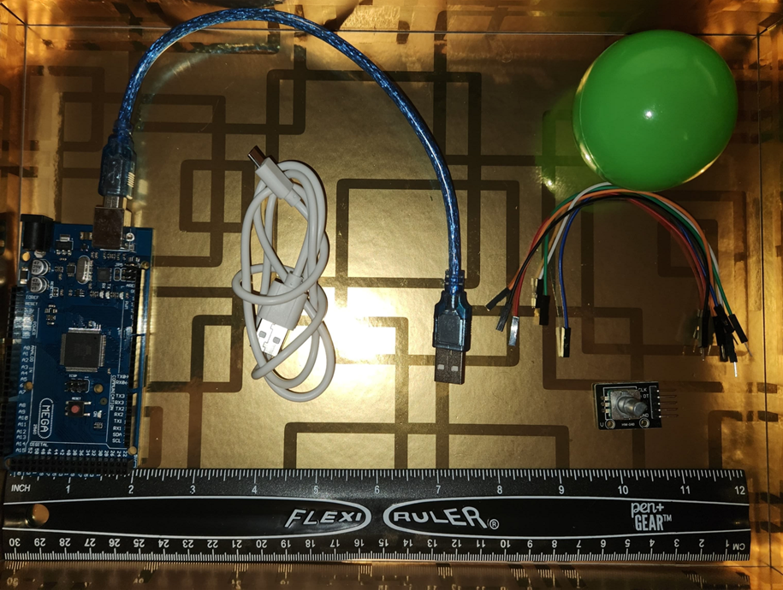
Project Necessities
Mega 2560 Board
Ultrasonic sensor HC-SR04
Male to Male Wires
Breadboard
USB cable
Ruler or tape measurer
Object to act as an obstacle and/or undergo free-fall

Slide 5
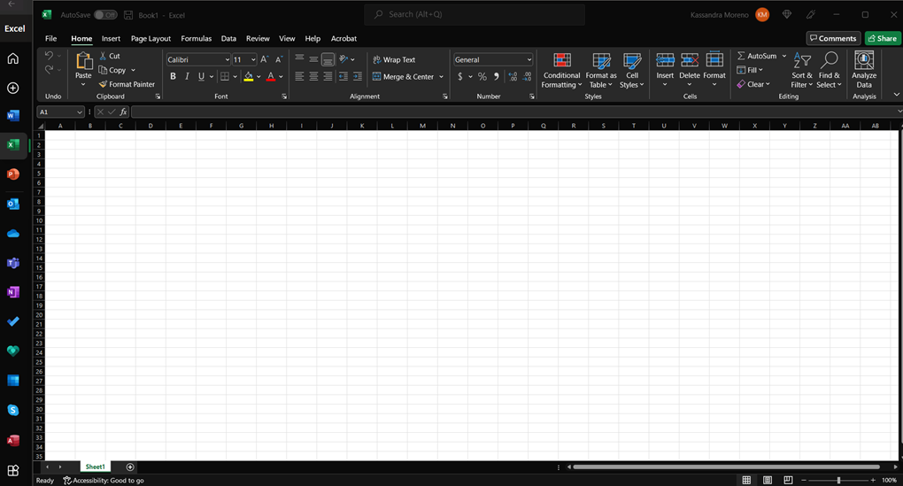
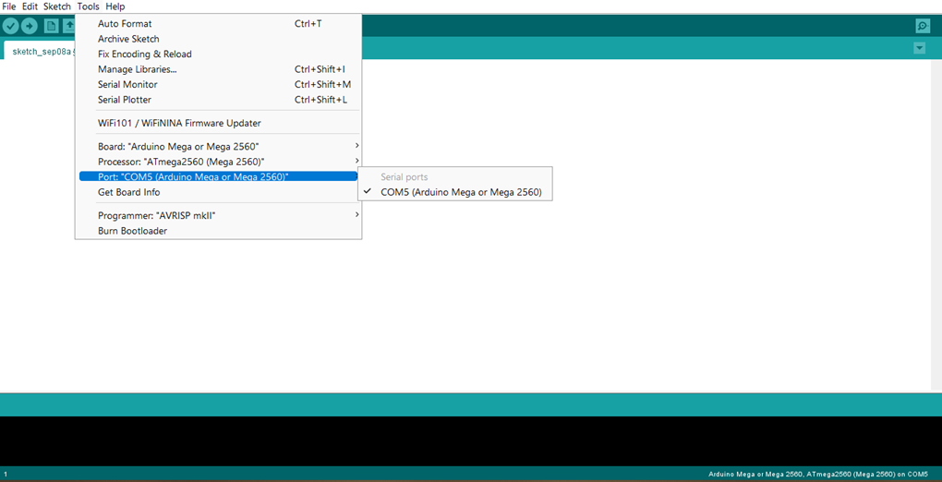
Required Software
Microsoft Excel
Arduino IDE

Slide 6
The Precision of an Ultrasonic Sensor
The ultrasonic sensor is an electronic device with two transducers that are used to detect objects within a certain range. When triggered, one transducer sends a burst of ultrasounds outward, and the other transducer listens for the ultrasounds to bounce off an object and return. In this project, the data we are observing is the amount of time it takes for the data to bounce back.

Slide 7
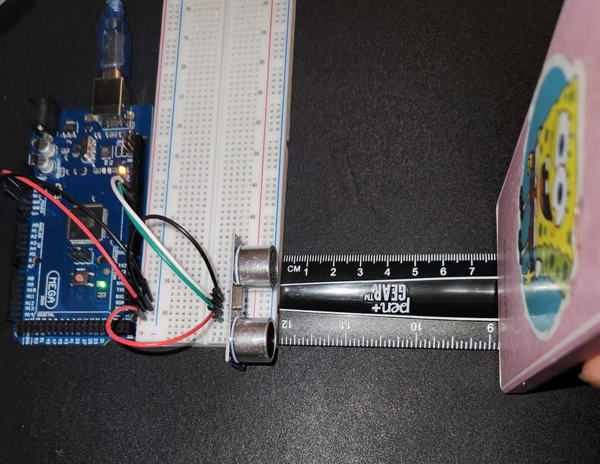
Experimental Set-up
Materials List:
Mega 2560 Board
Ultrasonic sensor HC-SR04
Male to Male Wires
Breadboard
Ruler or tape measurer
Object to act as an obstacle

Slide 8
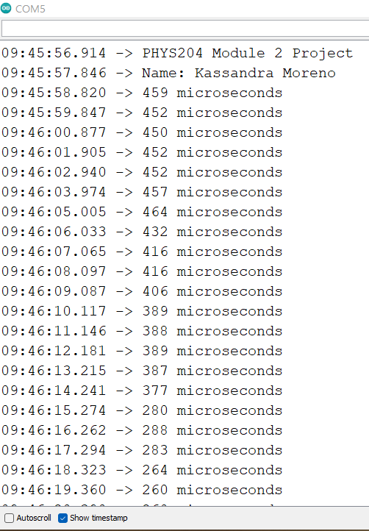
Raw Data

Slide 9
Data Collection
Trial | Ruler Distance (cm) | Total Roundtrip Distance (m) | Time from Serial Monitor (microseconds) | Roundtrip time (s) | Velocity = distance/time (m/s)
1 | 8 | 0.16 | 514 | 5.14e-4 | 311
2 | 7 | 0.14 | 429 | 4.29e-4 | 326
3 | 5 | 0.10 | 297 | 2.97e-4 | 337
4 | 4 | 0.8 | 214 | 2.14e-4 | 374
5 | 3 | 0.6 | 153 | 1.53e-4 | 392

Slide 10
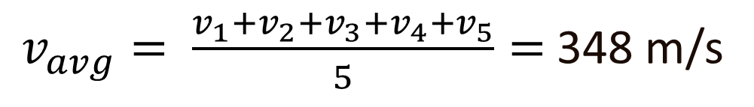
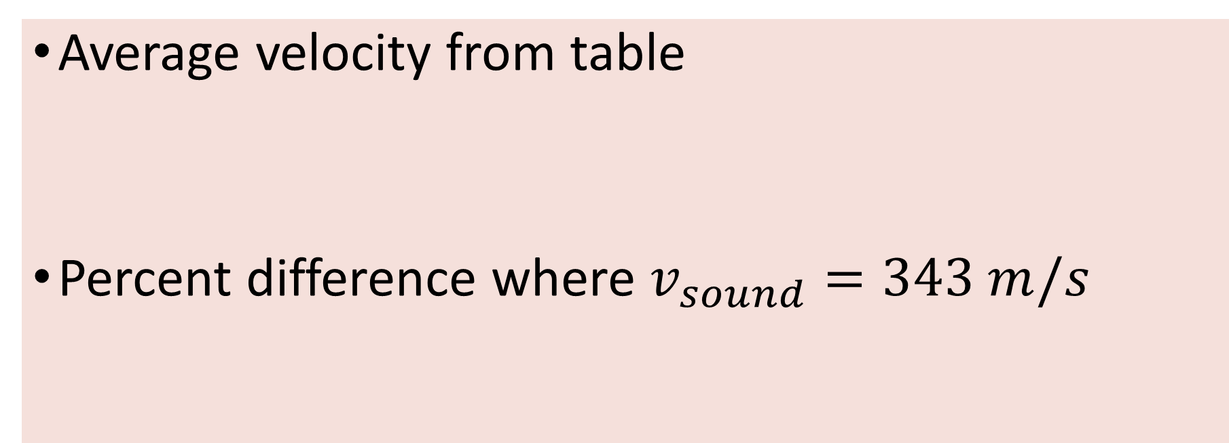
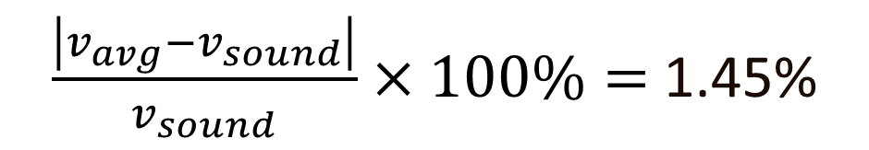
Data Analysis
Average velocity from table
Percent difference where $v_{sound}=343 m/s$
$v_{avg}= \frac{v_{1}+v_{2}+v_{3}+v_{4}+v_{5}}{5}=$ 348 m/s
$\frac{\left|v_{avg}−v_{sound}\right|}{v_{sound}}×100\%=$ 1.45%

Slide 11
Conclusions
Discuss the results and comment on the source of errors.
  Answer: The primary source of error I can think of is the stability of my object while being measured since I had to hold the object upright myself. Another error would be the ruler measurement since we can't get an exact measurement from an eye view.
What is the dependence of temperature, humidity, and atmospheric pressure on the speed of sound?
  Answer: temperature, humidity, and atmospheric pressure impact the speed of sound because they vary in molecular concentration. So hotter, more humid environments would slow the speed of sound, whereas a cold, non-humid environment would give the speed of sound less resistance.

Slide 12
Gravitational Acceleration
The objective of this experiment was to find the gravitational acceleration of a free-falling object using the ultrasonic sensor.

Slide 13
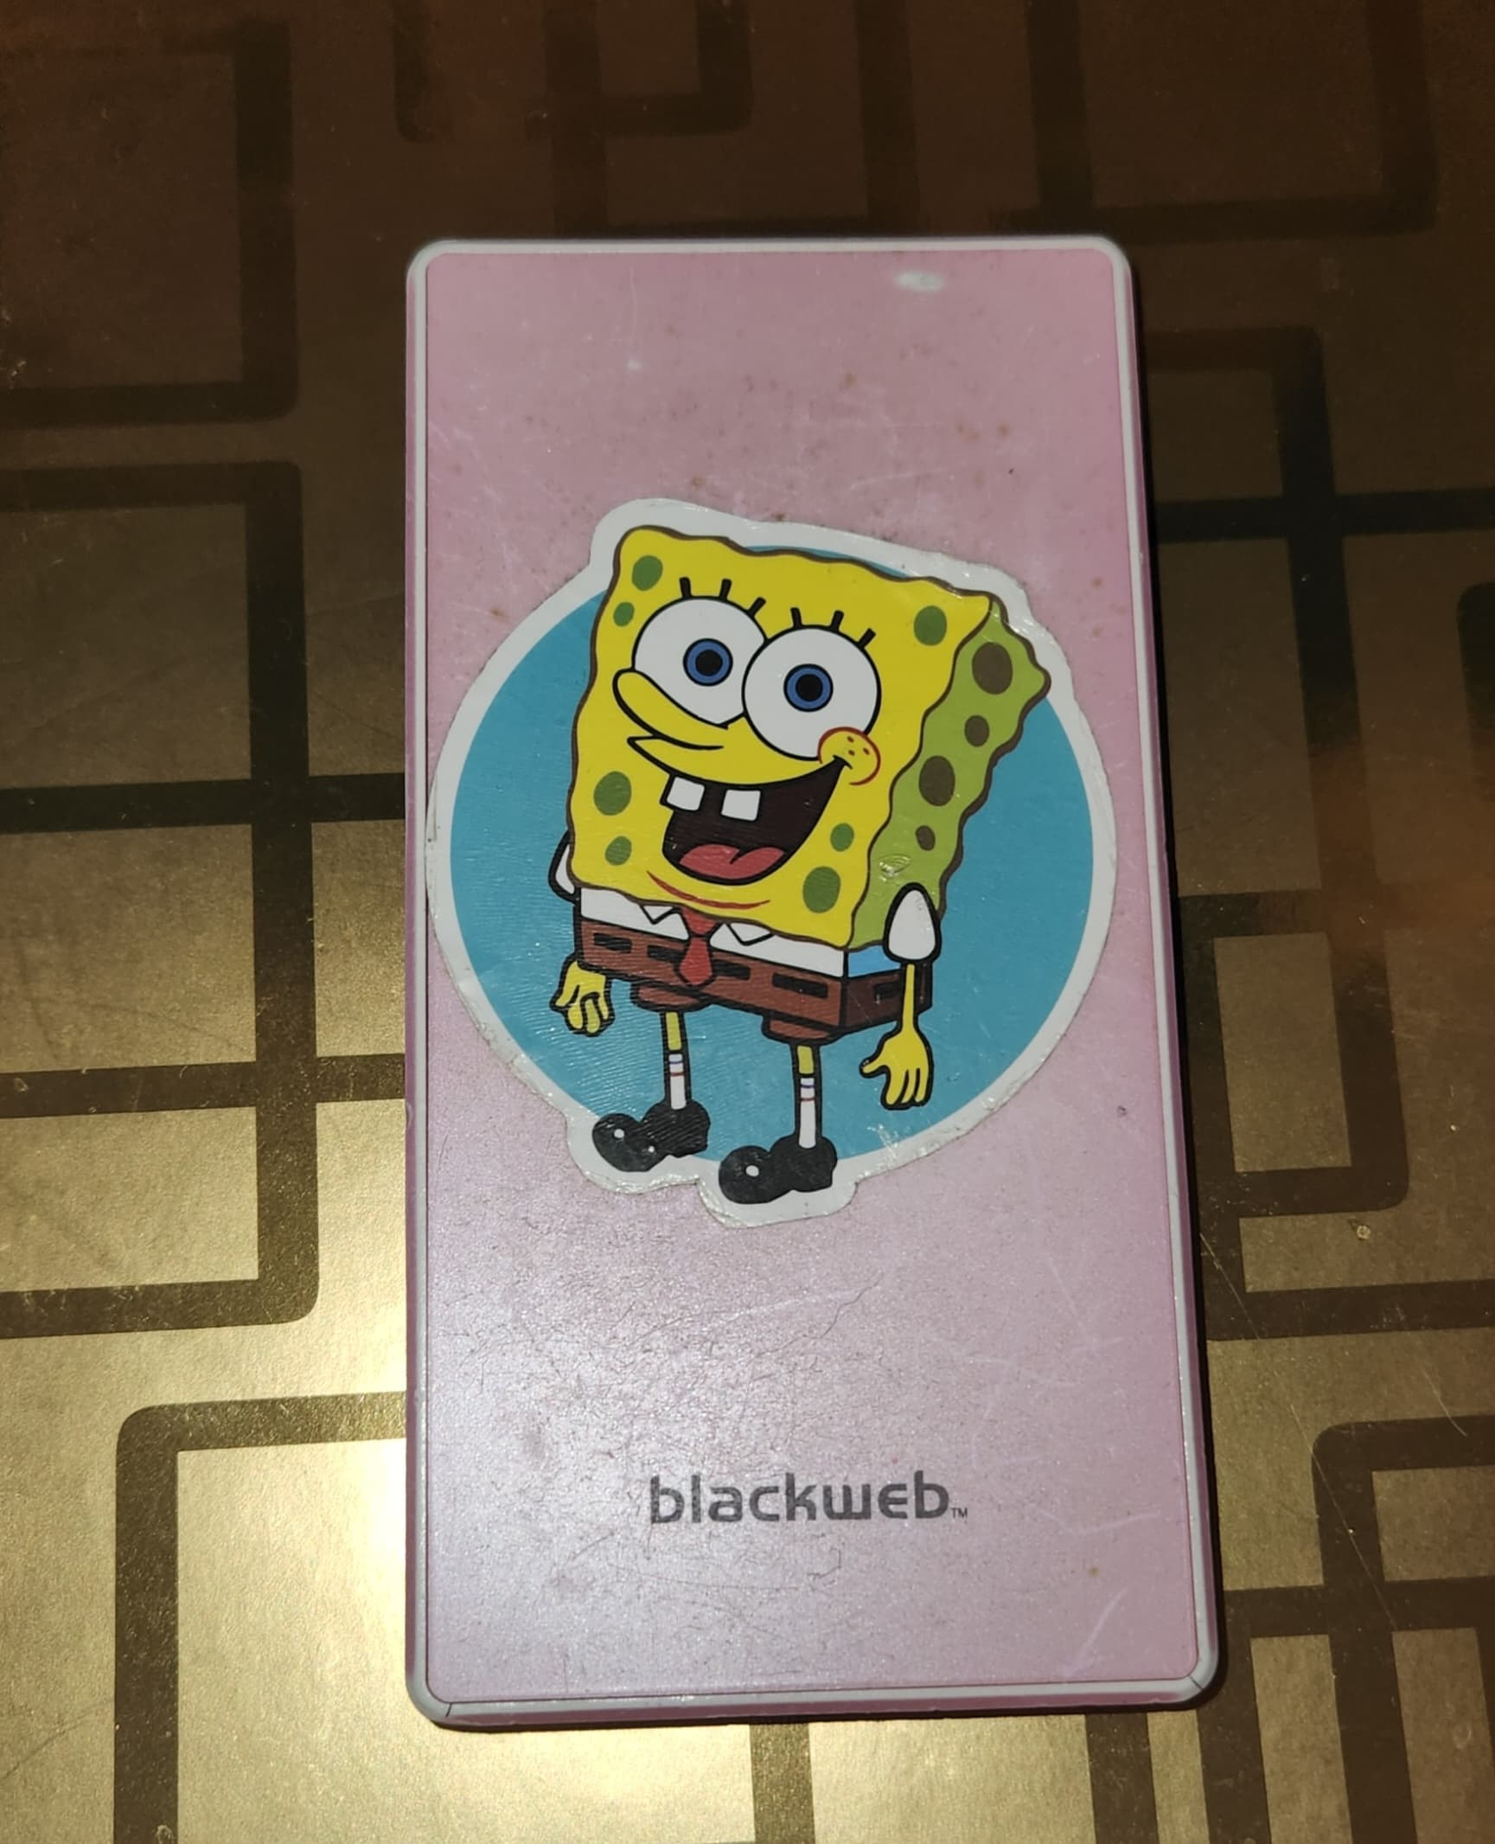
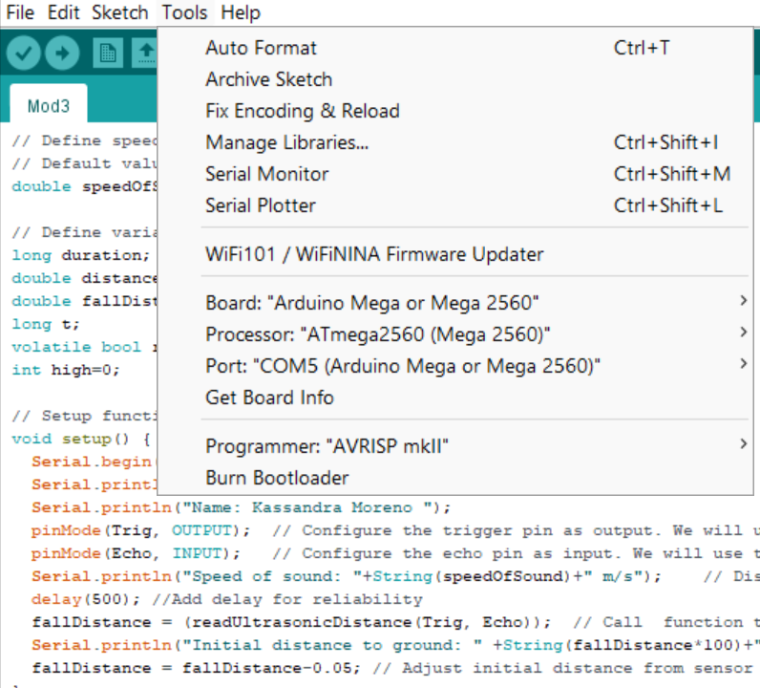
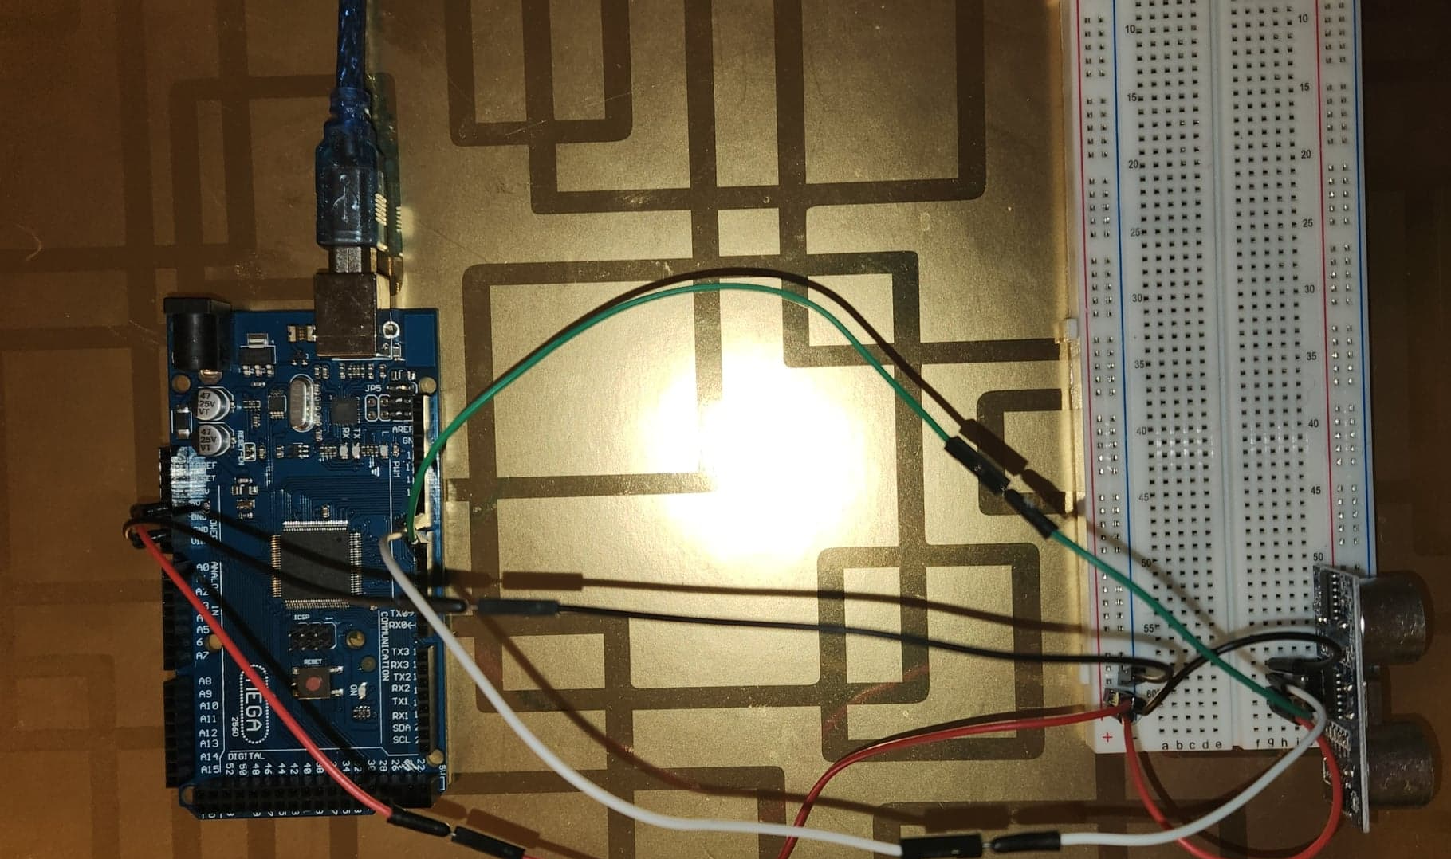
Experiment Set-up
Materials List:
Mega 2560 Board
Ultrasonic sensor HC-SR04
Male to Male Wires
Breadboard
Object to undergo free fall motion

Slide 14
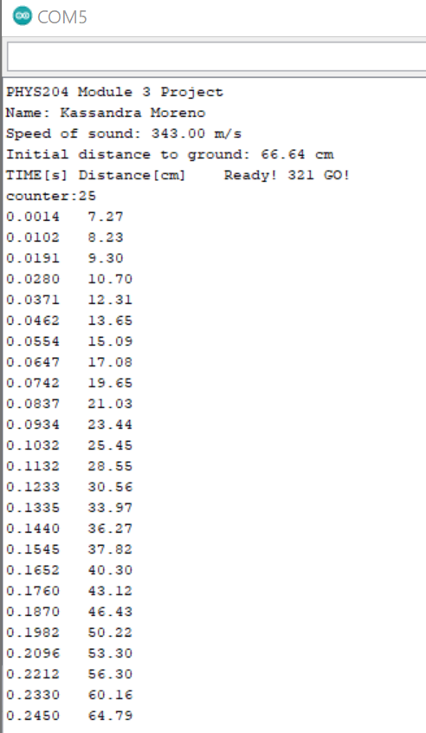
Serial Monitor

Slide 15
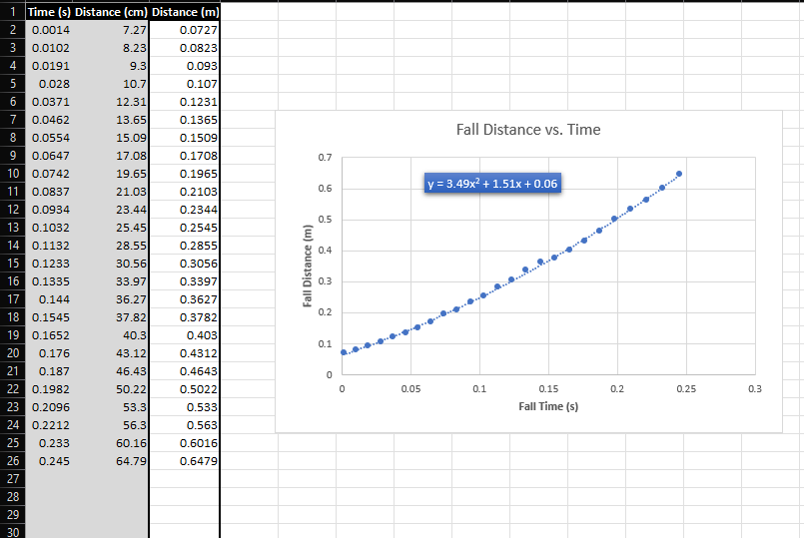
Excel Table
Excel table are for a single trial. The table shows the fall distance in centimeters and meters as a function of time

Slide 16
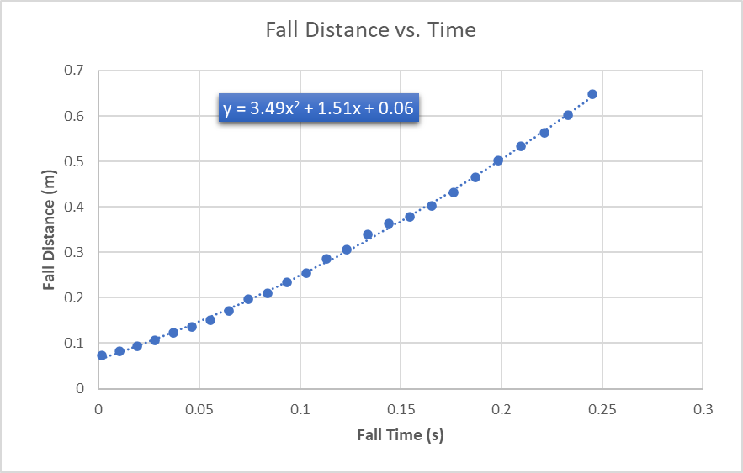
Excel Graph
Excel graph for previous single trial. Graph shows the fall distance as a function of time.

Slide 17
Data Collection
Trial | x² coefficient value from curve fitting | Acceleration (m/s²) = 2* (x² coefficient)
1 | 3.49 | 6.98
2 | 4.08 | 8.16
3 | 4.46 | 8.92
4 | 4.36 | 8.72
5 | 4.12 | 8.24

Slide 18


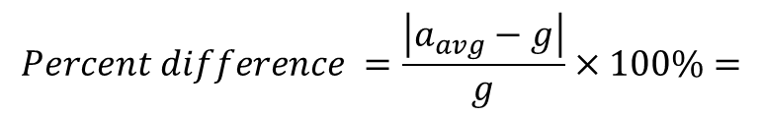
Data Analysis
Average acceleration from table = 8.204 m/s^2
Percent difference with $g=9.8 m/s^{2}$= 8.963%
$$a_{avg}= \frac{a_{1}+a_{2}+a_{3}+a_{4}+a_{5}}{5}$$
$$Percent difference =\frac{\left|a_{avg}−g\right|}{g}×100\%=$$

Slide 19
Conclusions
Discuss the results and comment on the source of errors.
  • When it comes to dropping objects by hand, it can be assumed that the results will never be the same. The source of error in this experiment would be human error. The distance held before the drop is never exact, and the angle at which the object is dropped is never precise.
How much variation is there from trial to trial? What does this indicate about the uncertainty of the result?
  • There is a slight variation when it comes t the calculated acceleration. This indicates that all my final calculations are average among the trials, which means that these answers have a high possibility of never being the same. This is a one-time calculation and can never be recorded as an absolute answer.

Slide 20
Conservation of Energy
The study of motion introduces the fundamentals of physics, which is understanding the nature and behavior of the physical world. The purpose of this lab is to demonstrate the transformation of energy. Here we will observe as one energy is transformed from one kind to another.

Slide 21
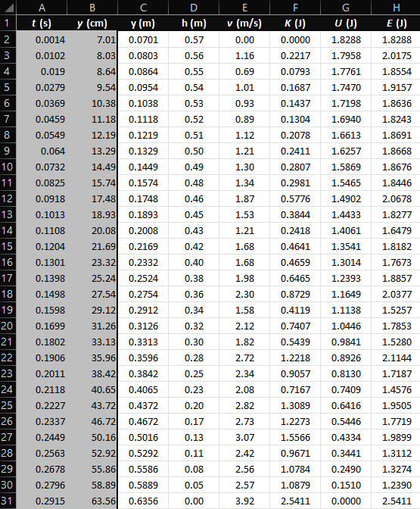
Excel Table
Excel table for a single trial showing the fall distance in centimeters and meters as a function of time with the values generated for kinetic energy K, potential energy U, and total mechanical energy E.

Slide 22
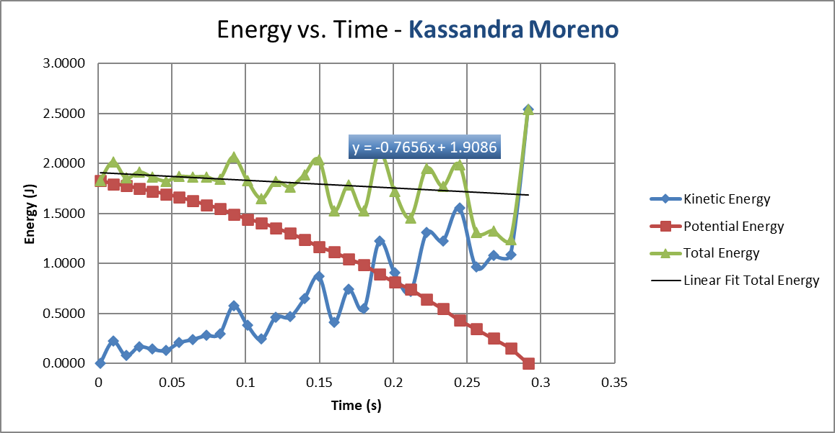
Excel Graph
Results of the single trial, show the plots of the kinetic energy K, potential energy U, and total mechanical energy E as a function of time.

Slide 23

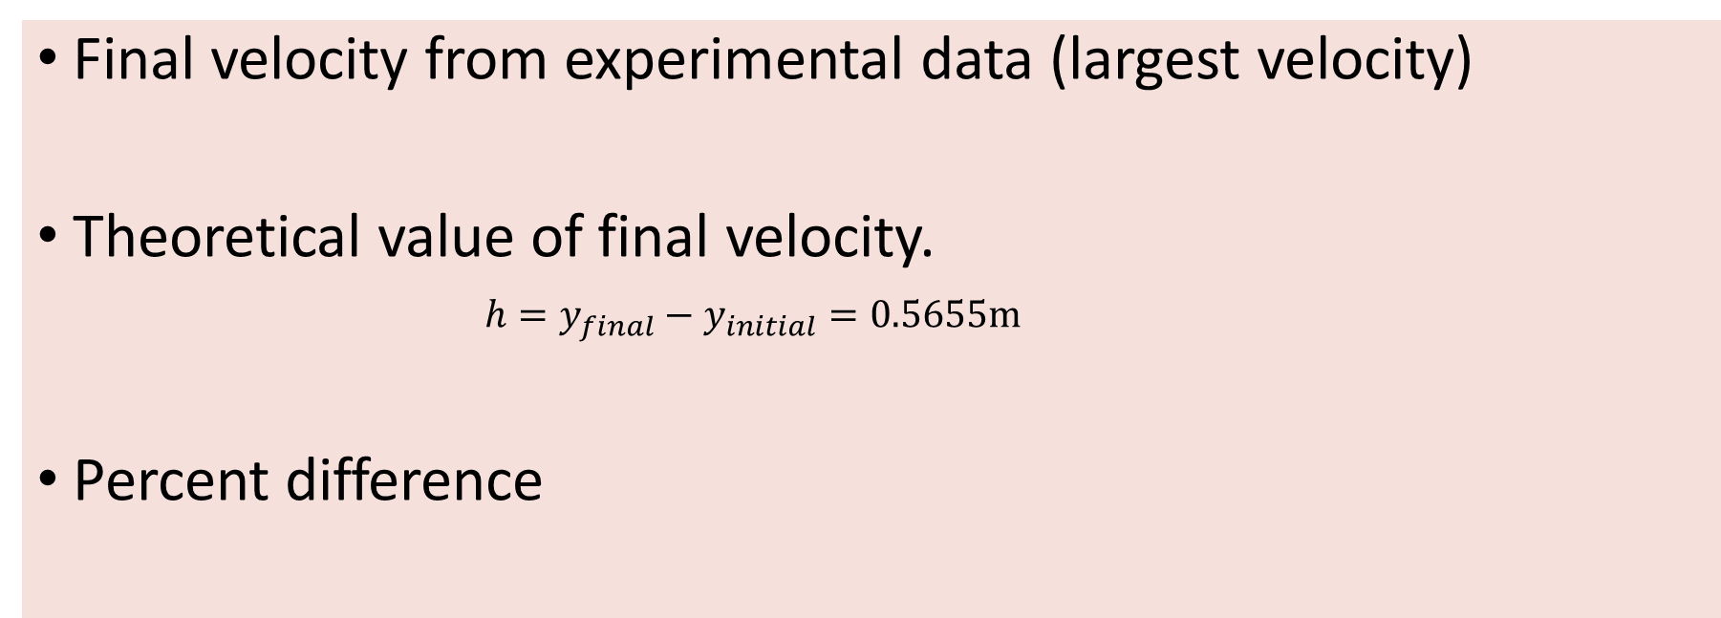
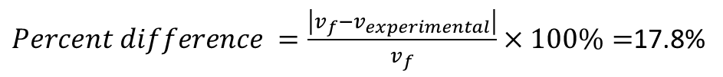

Data Analysis
Final velocity from experimental data (largest velocity)
Theoretical value of final velocity.
$h=y_{final}−y_{initial}=0.5655m$
Percent difference
$v_{experimental}$ = 3.92m/s
$v_{f}=\sqrt{2gh}$ =3.32m/s
$Percent difference =\frac{\left|v_{f}−v_{experimental}\right|}{v_{f}}×100\%=$17.8%

Slide 24
Conclusions
Discuss the key characteristics of the plot. Consider the times when U is max and min, when K is max and min, and when U and K are the same value. What is the significance of these points?
  Answer: U (potential energy) is at its maximized value at the beginning of the drop and at its minimum value at the end of the drop. While K (kinetic energy) is maximized at the end of the drop, and at its minimum value is at the beginning of the drop. U and K are at the same value somewhere near the midway point. The significant (I believe) is that the potential energy and kinetic energy switch.
What is the trend of the best fit line for the total energy E in your data? If the data is accurate, the total mechanical energy should decrease slightly. Why is that?
  Answer: The trend of the best fit line is that it slowly decreases as it nears the end of the drop. The total mechanical energy should decrease slightly because we would lose energy as the test continues. As potential energy converts to kinetic energy, some energies are lost to other points, such as sound, thermal energy, friction, etc.

Slide 25
Rotational Motion
Coming this far in our understanding of motion, we will now apply what we have learned about circular motion and convert radial displacement to linear displacement using the rotary encoder.

Slide 26
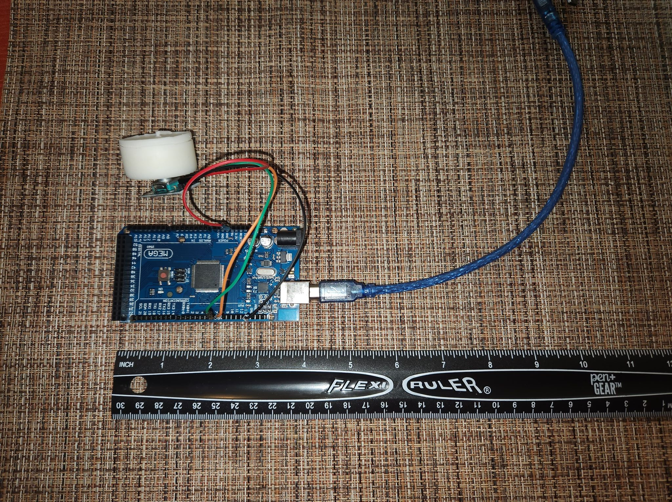
Experiment Set-up
Materials List:
Mega 2560 Board
Rotary Encoder Module KY-040
Male to Female Wires
Object to attach onto rotary encoder
Ruler or tape measurer

Slide 27
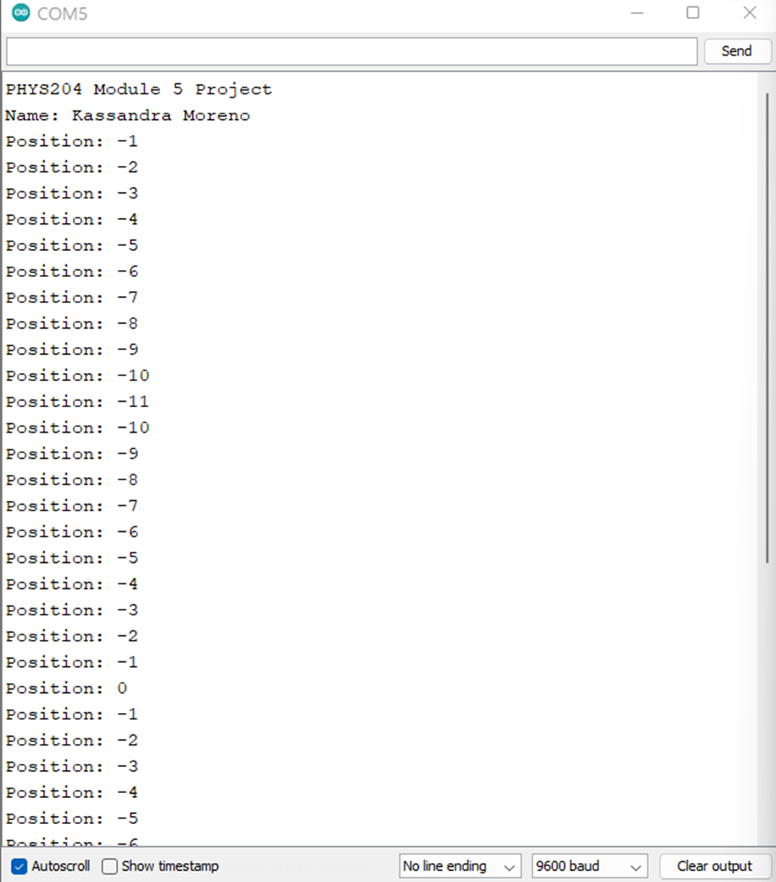
Raw Data

Slide 28
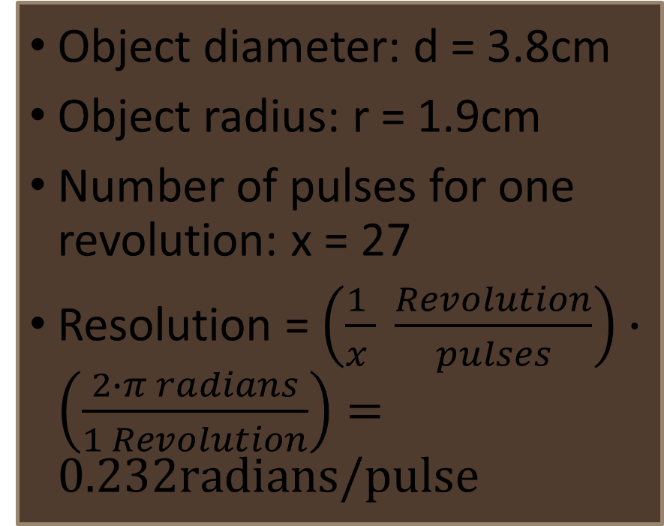
Data Collection
Object diameter: d = 3.8cm
Object radius: r = 1.9cm
Number of pulses for one revolution: x = 27
Resolution = $\left(\frac{1 }{x } \frac{Revolution}{pulses}\right)∙\left(\frac{2∙π radians}{1 Revolution}\right)=0.232radians/pulse$

Slide 29
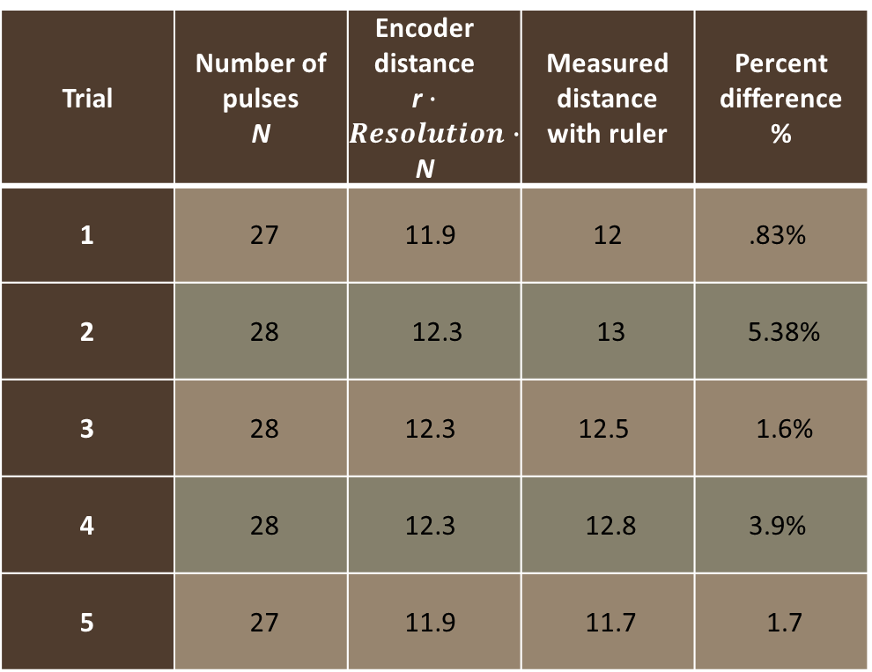
Data Analysis
Trial | Number of pulses N | Encoder distance r$∙Resolution∙$ N | Measured distance with ruler | Percent difference %
1 | 27 | 11.9 | 12 | .83%
2 | 28 | 12.3 | 13 | 5.38%
3 | 28 | 12.3 | 12.5 | 1.6%
4 | 28 | 12.3 | 12.8 | 3.9%
5 | 27 | 11.9 | 11.7 | 1.7

Slide 30
Conclusions
Discuss the results and comment on the reasons for errors.
  Answer: Results greatly vary due to human error. Since measurements were taken from an eye perspective, the measurements could never be considered exact. Also, my object was not consistent with friction resistance, which made the endpoint on the ruler vary.
What are some applications of this measuring technique? Could this measuring system be used to measure surfaces that are not flat?
  Answer: Wheels on a car, gears, factory lines, etc. Yes, this can be used for non-flat surfaces.

Slide 31
Hall Effect
Here, we investigate the Hall effect using the ESP32 microprocessor. I’ve measured the proportional voltage under the effect of a magnet.

Slide 32
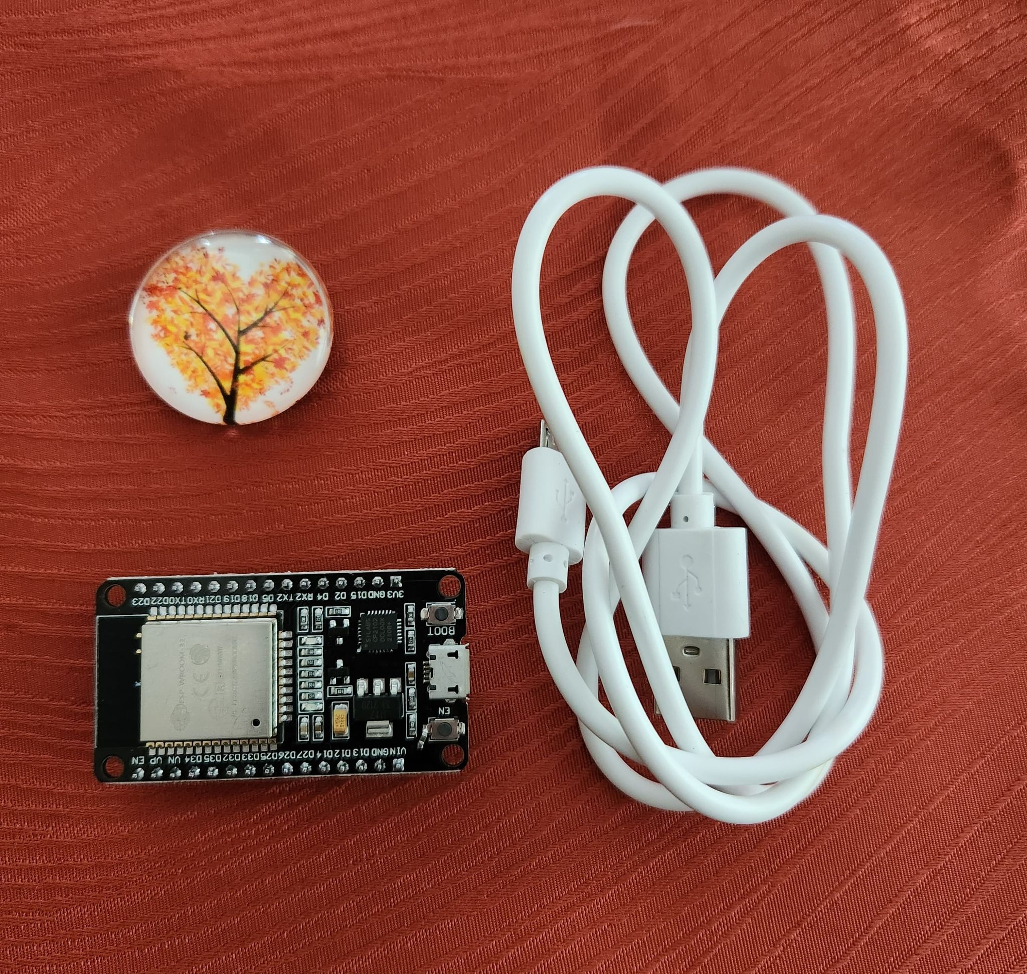
Experimental Set-up
Materials List:
ESP32 microprocessor
Micro-USB cable
Magnet

Slide 33
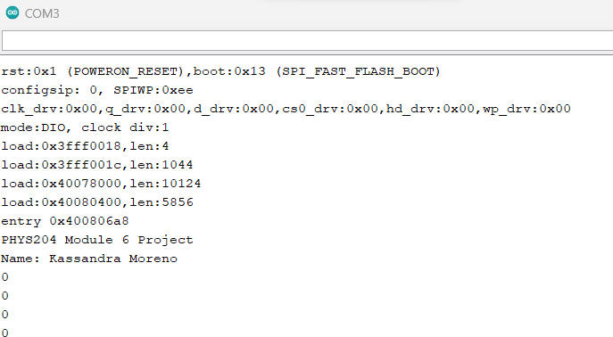
Raw Data

Slide 34
Data Analysis

Slide 35
Conclusions
Discuss the results and comment on how the Hall sensor works.
  Answer: The Hall effect sensor results show evidence that the sensor’s output range increases as a magnetic pull draws closer and decreases as the magnet gets pulled away. The data analysis shows that the output range can be either positive or negative; this is a reaction to the magnetic sensor detecting either the positive or negative side of the magnet. The positive side will output negative numbers, and the negative side will output positive numbers.
What are some applications for the Hall effect sensor?
  Answer: The Hall effect is the most common measuring magnetic field. This is applied to wheel speed, proximity, polarity, and conductivity determination.

Slide 36
Challenges
Physics concepts do not come naturally to many of us, so sometimes, it is necessary to see motions and calculations through experiments. While experiments help, they also, like physics, come with their own challenges. I personally ran into a few technical issues along the way, and I would say that was my biggest challenge. These challenges were resolved through a lot of trial and error and equipment research.

Slide 37
Career Skills
As I progress through these courses to one day become a software engineer, I find every subject does me a great service in development. This introduction to physics has benefited me in many ways, but I would say the most significant benefit was enhancing my problem-solving and critical-thinking skills in complex situations or mathematical problems.

Slide 38
Conclusion
In this presentation we explored the laws of physics through labs I have conducted and documented in the past eight weeks. This presentation demonstrated my first encounters in observing the laws of physics regarding ultrasonic sensors, gravitational acceleration, energy conservation, rotational motion, and the Hall effect.

